Slide 1
Information Security Risk Assessment
John McGarvey
Introduction to Ethical Hacking

Slide 2
What is Info Security Risk Assessment?
The process of identifying, assessing, and reducing risks to an acceptable level
  Defines and controls threats and vulnerabilities
  Implements risk reduction measures
An analytic discipline with three parts:
  Risk assessment: determine what the risks are
  Risk management: evaluating alternatives for mitigating the risk
  Risk communication: presenting this material in an understandable way to decision makers and/or the public

Slide 3
Risk Assessment
What is risk assessment?
  Are a means of providing decision-makers with information needed to understand factors that can negatively influence operations and outcomes
  To make informed judgements concerning the extent of the actions needed to reduce risk.

Slide 4
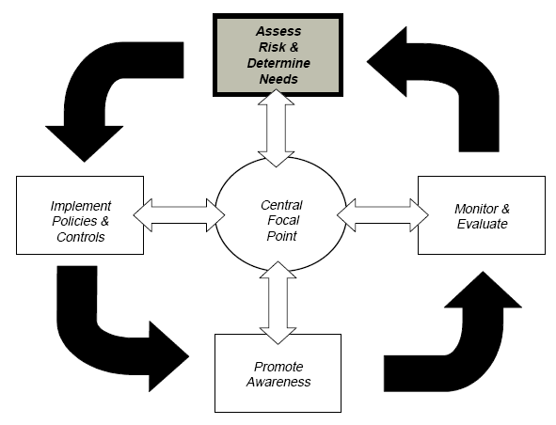
The Risk Management Cycle
Fig 1 The elements of the risk management cycle – GAO information security risk assessment

Slide 5
Elements of risk assessment
  Identify threats that could harm and thus adversely affect critical operations and assets.
  Threats include such things as intruders, criminals, disgruntled employees, terrorists and natural disasters.
  Info Security Risk Assessment focuses on threats from others (actors) who wish to access your PC, Network to steal data or config info.
  Estimating the likelihood that such threats will materialise based on historical information and judgement of knowledgeable individuals.

Slide 6
Elements of risk assessment
Identifying and ranking the value, sensitivity and criticality of the operations and assets that could be affected should a threat materialise.
RA is completed in order to determine which operations and assets are the most important.
Estimating for the most critical and sensitive assets and operations, the potential losses or damage that could occur if a threat materialises including recovery costs

Slide 7
Elements of risk assessment
Identify cost effective actions to mitigate or reduce the risk.
  Actions can include implementing new organisational policies & procedures
  Software control and/or physical controls
  Often requires updating of Software to the most recent versions (why?)
Documenting the results and developing an action plan

Slide 8
Risk Assessment Structure
Evaluate
  Value of computing and information assets
  Vulnerabilities of the system
  Threats from inside and outside
  Risk priorities
Examine
  Availability of security countermeasures
  Effectiveness of countermeasures
  Costs (installation, operation, etc.) of countermeasures
Implement and Monitor
  Wireshark
  Application Firewalls (WAFs)

Slide 9
Who gets involved in Risk Assessment?
Internal domain experts
  Senior individuals in the department/team who know the systems, processes and data the best.
  Not a manager why ?
  Knows best how things really work, the shortcuts, weaknesses etc.
Managers responsible for implementing controls
CyberSecurity Experts -

Slide 10
What to protect - Assets
Asset – Anything of value, from a document to a database, from a PC to a Print Server. We can break them into two groups, physical and logical
Physical Assets
  Laptops
  PCs
  Servers
  Buildings, computers
Logical Assets (Software)
  User Accounts for
    Email
    DBs
    Systems (OS)
    Servers and others (Cloud and private)
  Intellectual property, reputation

Slide 11
Critical Assets
People and skills
Hardware/Software
Data
Documentation
Supplies
Money

Slide 12
What is a threat?
An expression of intention to inflict evil injury or damage. Normally conducted by a Threat actor
Attacks against the 3 major areas of Security
  Confidentiality (Data being stolen/hacked)
  Integrity (Undesired changes to Data and messages while in transit)
  Availability – Of the computing resource, often servers/services (Blackboard, Core, Email, DBs)

Slide 13
Quantitative Risk Assessment
Quantitative approach looks at the monetary cost of risk. The risk reduction techniques it uses includes:-
  The likelihood that a damaging event will occur
  The cost of the potential damage/loss
  The costs of mitigating actions that could be taken
  Example – A work laptop is stolen from the boot of an employees car while in Dublin. – What is the cost of the replacement of the 2018 DELL Latitude?

Slide 14
Qualitative approach
Relies on reliable data being available.
Risk can be more subjective and can be categorised in terms of high, medium and low.
Depends more on the availability of expertise, experience and judgement of those conducting the assessment.
  Often this will require interviews with the senior people within the department to see how data is processed and used.

Slide 15
Quantify cost of Risk occurring?
Data factors are constantly changing
  Data are limited on risk factors, such as the likelihood of a sophisticated hacker attack and the costs of damage, loss or disruption caused by events that exploit security weaknesses
  Some costs such as loss of customer confidence or disclosure of sensitive information are inherently difficult to quantify
  Although the cost of h/w and s/w needed to strengthen controls may be known, it is often not possible to precisely estimate the related indirect costs, such as the possible loss of productivity that may result when new controls are implemented

Slide 16
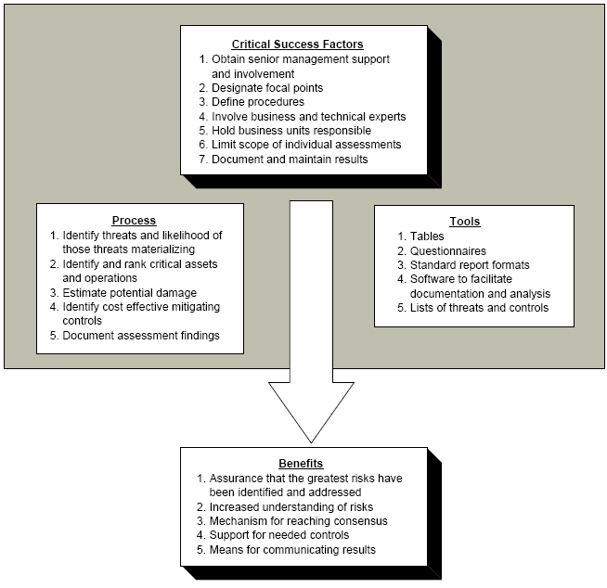

Slide 17
Critical success factors
Helped to identify programs that were efficient and effective for the organisation.
Use the senior managements expertise and experience, conduct the assessment in an efficient manner that led to remedial actions being taken.

Slide 18
Senior management involvement
To ensure that an assessment program is taken serious by lower levels employees within the organisation.
To ensure that resources are available to implement the program and to implement any actions required such as changes to policies and controls.

Slide 19
Designate focal points
Involved the setting up of groups or individuals to oversee and guide the company through this process which involved:-
  Planning
  Performance
  Reporting of the risk assessment program
Often the focal point will be a person who has experience in conducting Risk assessment (consultant) or another employee in the company.
Their experience helps as they know
  Assets (Email, Systems)
  Type of risks (internal/external)
  Threat actors
  Countermeasures – controls etc.

Slide 20
Positive effects of having experienced individuals
The use of focal points enhanced the quality and efficiency of the risk assessments.
It also helped to coordinate the planning and performance of the risk assessment
Tools were used effectively under the direction of the experienced individual
Successful techniques were applied to subsequent assessments
Terms and methods were applied consistently
Reports were developed quickly and to the agreed format
Expectations of the senior management were met

Slide 21
Define procedures
Define and document procedures for conducting risk assessments
Develop tools to standardise the process
All this helps to achieve consistency
Flexibility was achieved by allowing procedures to be altered and shared to promote “best practice”

Slide 22
Defined procedures specify
Who was responsible for initiating and conducting RA
Who was to participate
What steps were to be followed
How disagreements were to be resolved
What approvals were needed
How assessments were to be documented
How documentation was to be maintained
To whom reports were to be provided

